Slide 2
Akabane disease (AKA)
Enzootic bovine arthrogryposis
and hydranencephaly
^{By}
Dr/ Marawan Elfky

Slide 3
Definition
Arthropod-transmitted viral disease.
Ch. by congenital abnormalities in calves, lambs and kids in a form:
Arthrogryposis (joint immobility or ankylosed)
Hydranencephaly (absence of cerebral hemisphere)
In adult, abortion and mummification, still birth or premature birth.

Slide 4
Etiology
Akabane virus (ssRNA)
Family (Bunyaviridae)
Genus (Orthobunyavirus).
Simbu serogroup.
Can be isolated in suckling mice (I/C) and cell cultures
Sensitive to heat and UV light.

Slide 5
Epidemiology
Distribution: Tropical and subtropical areas and recognized in Australia, Israel, Japan, and Korea (middle east showed antibodies only).
Host rang:
Wide range of domesticated ruminants and wildlife.
Cattle, sheep and goat are frequently infected.
Asymptomatic infection (horses, buffalo, deer, and pigs).

Slide 6
Seasonal incidence: Summer and early autumn.
Transmission:
Source: Infected blood contain virus.
Mode:
Mainly horizontal transmission: through biting midges (Culicoides)
Vertical transmission is also important (less).

Slide 7
5. Economic and zoonotic importance
Deaths in young animals.
Abortion, mummification and still birth in adults.
Not Zoonotic

Slide 8
Pathogenesis
After insect biting viremia occurs for 3-5 d then the virus penetrate placenta & multiply causing abortion or still birth or birth of calves or lambs with congenital anomalies.
The most susceptible stages of gestation in small ruminants range from 1-2 months and in cattle from 3 -6 months.
In the latter stages of gestation the incidence of abnormalities declines to a very low level.

Slide 9
Clinical signs
I.P is short (1-6 d.) with low morbidity and mortality.
Adult; usually asymptomatic except some signs including fever, abortion, still birth or premature birth and dystocia.
Calves, lambs and kids; Congenital anomalies as arthrogryposis and hydranencephaly.

Slide 10
1. Arthrogryposis (3-4 m. of pregnancy):
Calves are born underweight or small in size and usually die at birth.
Initially, only one or two joints may be affected on a single limb.
Later, severe fixation of multiple joints on all limbs and muscular atrophy so the calves are unable to raise or stand or walk,
Sever deformities of vertebral column (incomplete closure of spinal canal or lateral deviation of the spine).

Slide 11
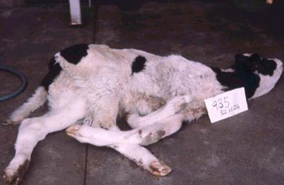
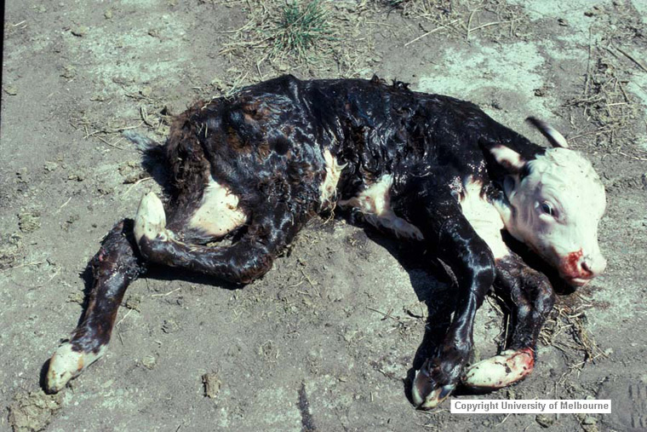
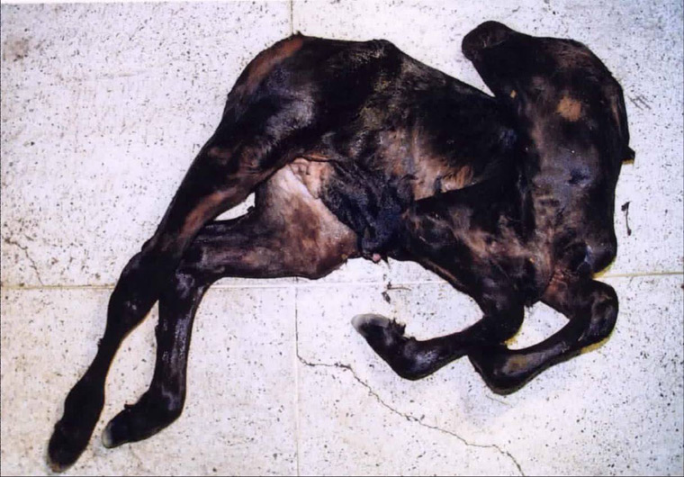
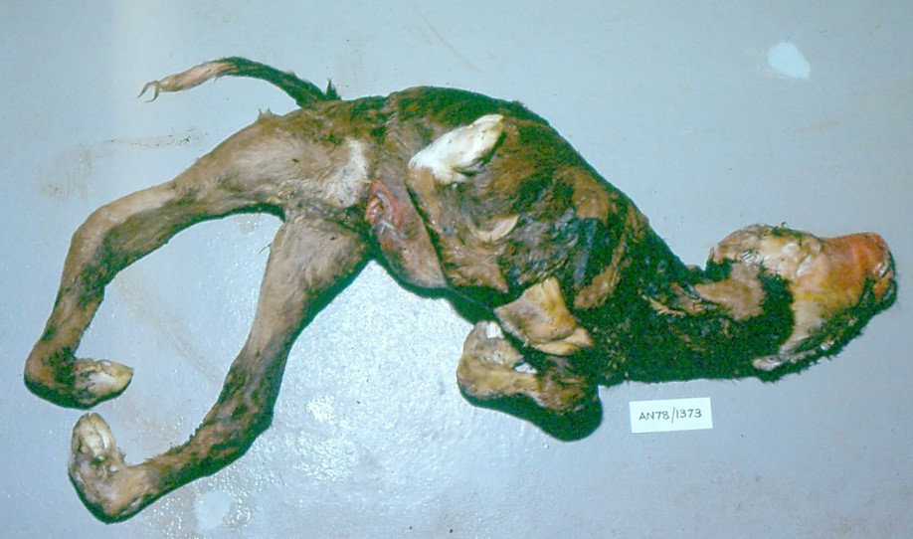

Slide 12
2. Hydranencephaly (5-6 m. of pregnancy):
Calves have varying degrees of cavitation of cerebral hemispheres, ranging from porencephaly to severe hydranencephaly.
Lack of intelligence, blindness, absence of dam seeking reflex, torticollis and may survive for months if they are hand reared but will not grow.
Some calves with micrencephaly show unable to stand, incoordination, ataxia, paralysis, blindness, deafness, nystagmus, dullness, slow suckling and dysphagia.

Slide 13
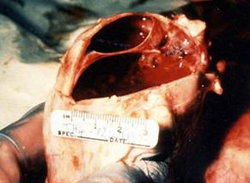
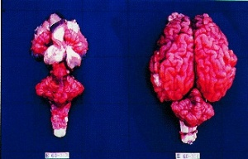

Slide 14
P/M lesions (Muscles and CNS)
Arthogryposis; affected joints cannot be straightened
Subcutaneous haemorrhages in fetus.
Hypoplasia of the skeletal muscle
Opthalmia and cataracts
Hydranencephaly and or microencephaly
Agenesis of the brain and agenesis or hypoplasia of the spinal cord

Slide 15
Diagnosis
1- Field diagnosis; depends on case history, clinical signs and P/M lesions.
2. Lab. Diagnosis;
Sample:
Fetus, fetal membranes and fluids
Brain, CSF, caught culicoides
Blood and paired serum (preclostral sera)

Slide 16
Diagnosis
B. Laboratory procedures:
Serological investigation using ELISAs, AGIDT.
Virus isolation on in cell lines including hamster lung (HmLu-1) and baby hamster kidney (BHK-21) cells.
Detection of the viral nucleic acid using RT-PCR.
Laboratory animal’s inoculation, intracranial injection of mice or hamster cause non-suppurative encephalitis

Slide 17
Differential Diagnosis
The disease should be differentiated from all causes of congenital anomalies as: (Manganese deficiency, inherited arthrogryposis, Border disease, BT, BVD and poisoning as in datura etromaitum, tobacco and lupines)
Treatment
No treatment

Slide 18
Control & vaccination
Vector control, such as covering breeding sites and using insect repellents and insecticide treatments.
Disinfection using hypochlorite, glutaraldehyde, 70% alcohol, hydrogen peroxide.
Introduction of stock from non-endemic areas.
Vaccination using live attenuated or inactivated vaccine is available in endemic localities.

